Slide 1



Benchmarking for Neural Information Retrieval
MS MARCO, TREC, and Beyond
Bhaskar Mitra
Principal Applied Scientist
Microsoft
@UnderdogGeek
bmitra@microsoft.com

Slide 2
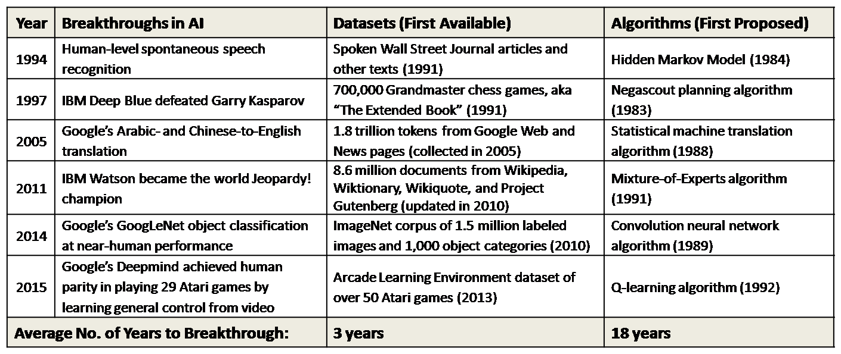
What came first, the dataset or the algorithm?
https://www.kdnuggets.com/2016/05/datasets-over-algorithms.html

Slide 3
A brief timeline of deep learning for search
2016
2017
2018
2019
2020

Slide 4


Deep learning is “in the air”
% of neural IR papers @ SIGIR
8%
2016
I’m certain that deep learning will come to dominate SIGIR over the next couple of years … just like speech, vision, and NLP before it.
2017
Christopher Manning
(SIGIR 2016 Keynote)
2018
2019
2020

Slide 5
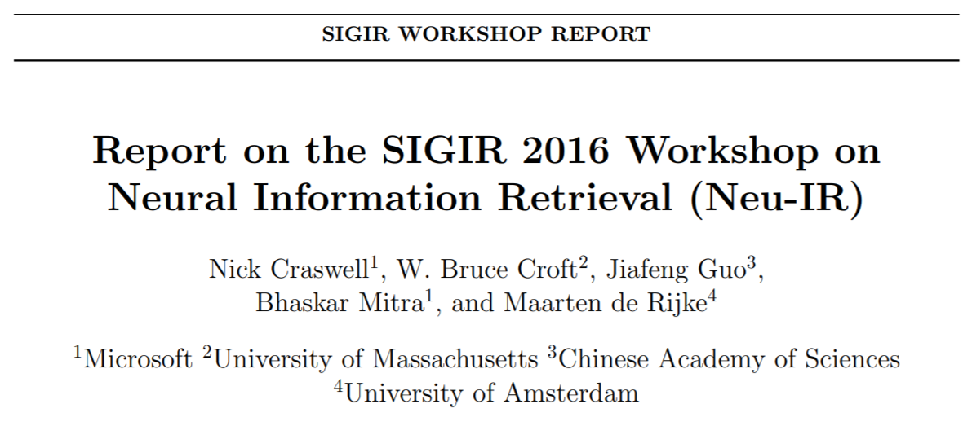
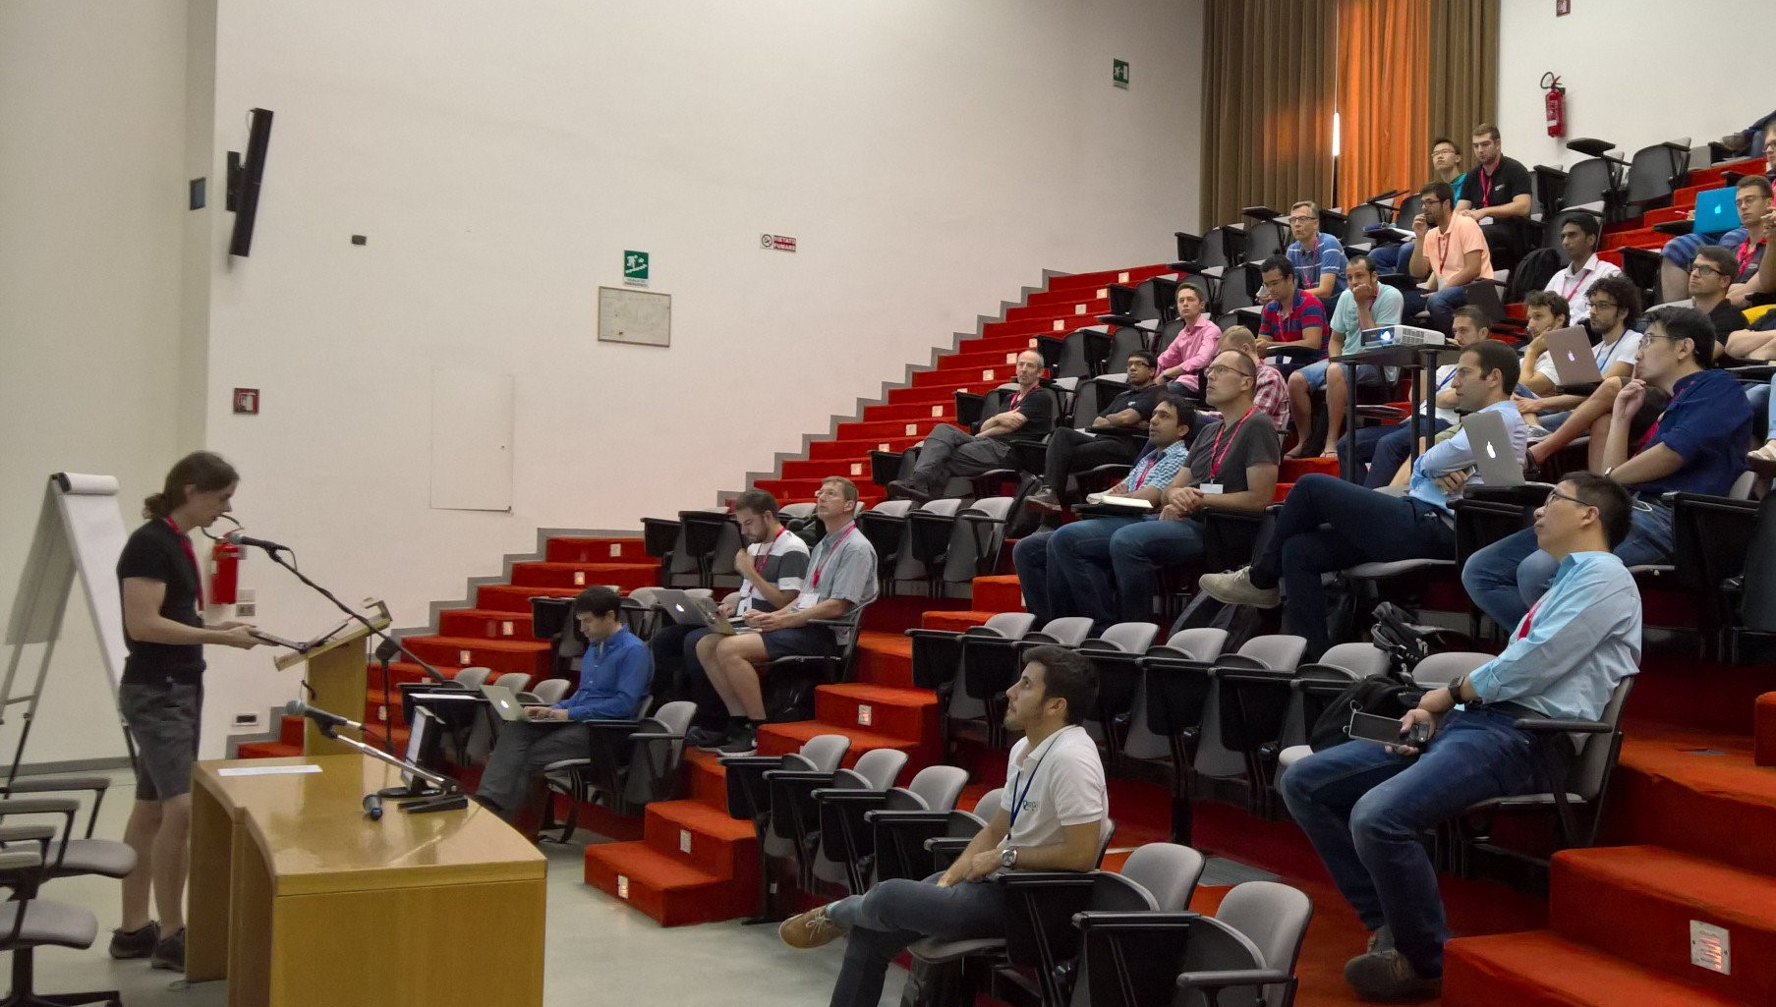
Deep learning is “in the air”
% of neural IR papers @ SIGIR
8%
2016
2017
2018
2019
2020

Slide 6
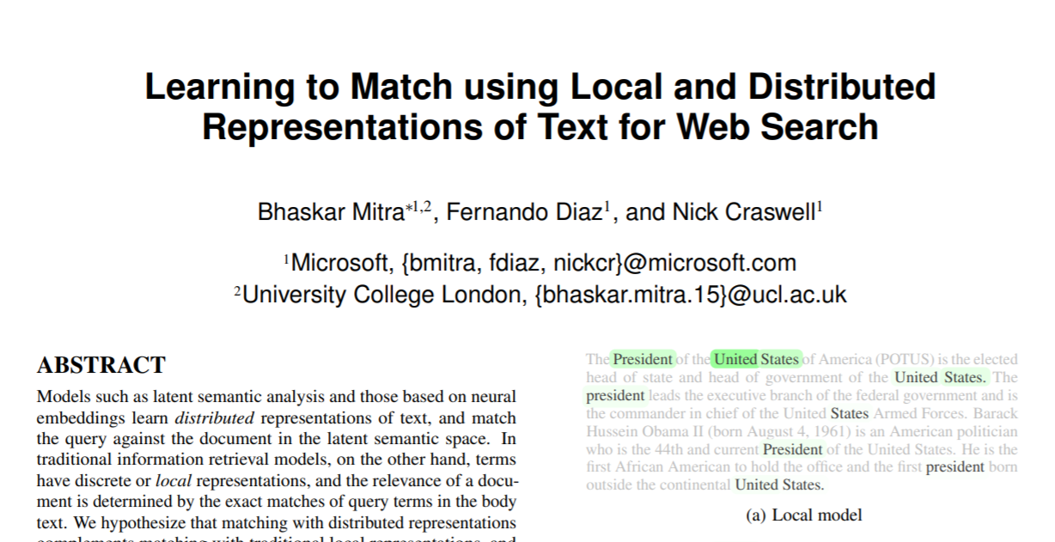
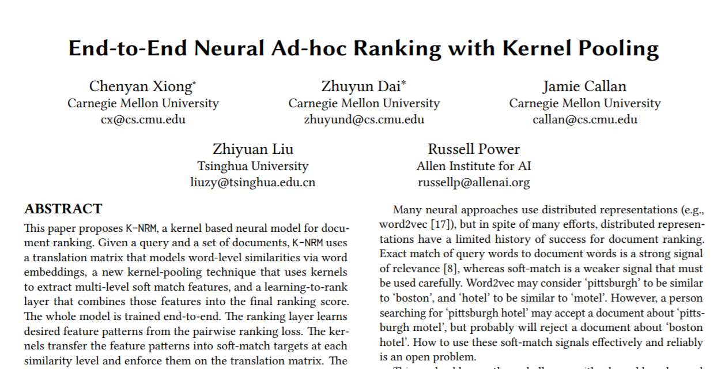
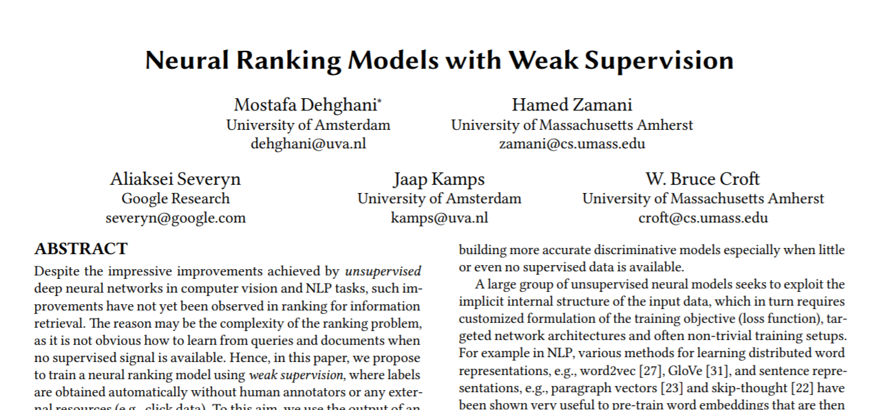
Several new deep learning papers for document ranking
% of neural IR papers @ SIGIR
8%
2016
Duet
23%
2017
2018
KNRM
2019
2020
Weak supervision

Slide 7
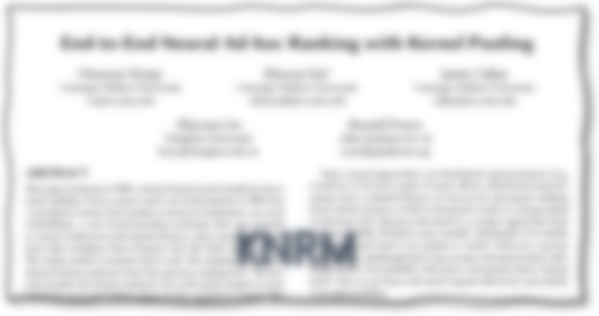

Trained on 200K English queries from Bing.com (proprietary dataset)
% of neural IR papers @ SIGIR
8%
2016
Duet
23%
2017
2018
2019
2020

Slide 8

% of neural IR papers @ SIGIR
8%
2016
23%
Trained on 95K Chinese queries from Sogou.com (public dataset)
2017
2018
KNRM
2019
2020

Slide 9
% of neural IR papers @ SIGIR
8%
2016
23%
2017
2018
Trained using BM25-based weak labels
2019
2020
Weak supervision

Slide 10
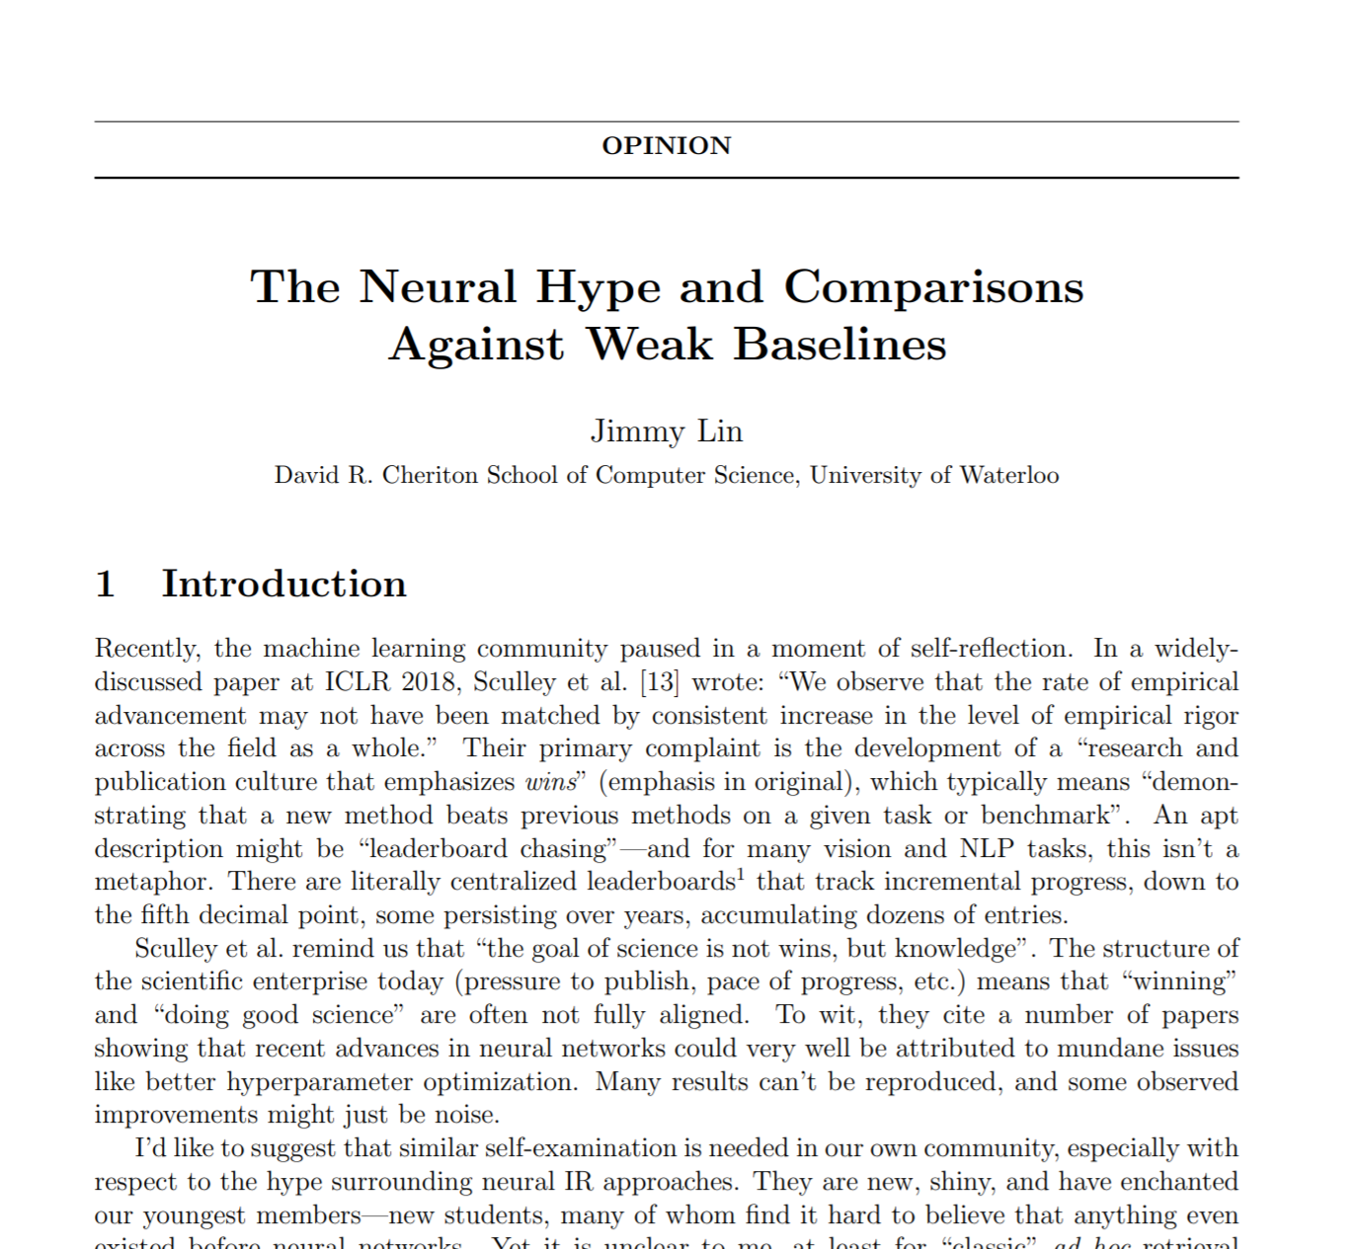
But are we making real progress?
% of neural IR papers @ SIGIR
8%
2016
23%
2017
42%
2018
¯\_(ツ)_/¯
2019
2020

Slide 11

We launched the MS MARCO passage ranking benchmark with 0.5M+ English training queries
% of neural IR papers @ SIGIR
8%
2016
23%
2017
42%
2018
Passage Ranking Leaderboard
2019
The myth of “no neural IR model worked before BERT”: first generation deep ranking models, e.g., Duet and KNRM, and their variants, outperform (till date) most traditional IR methods by a fair margin on the MS MARCO benchmark
2020

Slide 12

% of neural IR papers @ SIGIR
8%
2016
And then…
23%
2017
42%
2018
Google’s BERT paper posted on arXiv
2019
2020

Slide 13
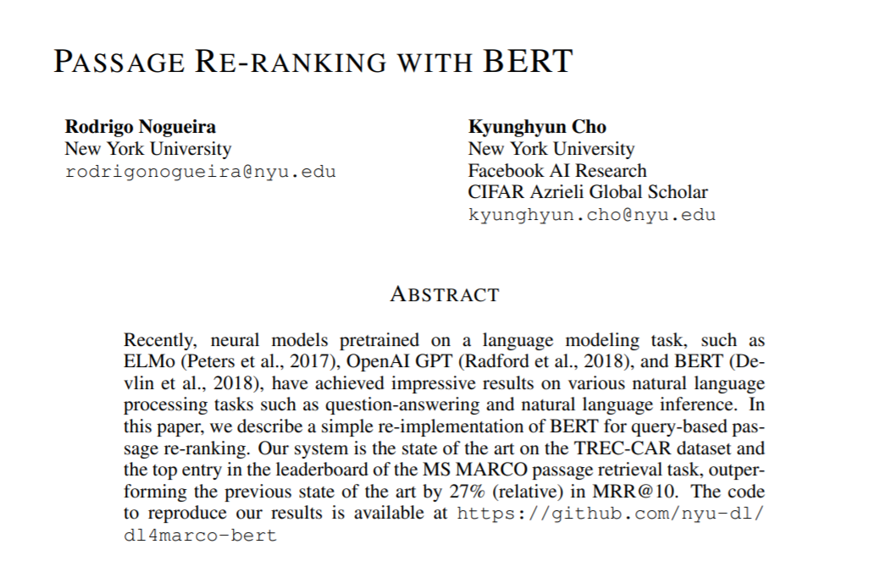
Less than 3 months after the BERT paper was uploaded to arXiv
% of neural IR papers @ SIGIR
8%
2016
23%
2017
42%
2018
First BERT-based ReRanking model achieves 0.359 MRR compared to previous SOTA of 0.281 on MS MARCO
😱
58%
2019
2020

Slide 14
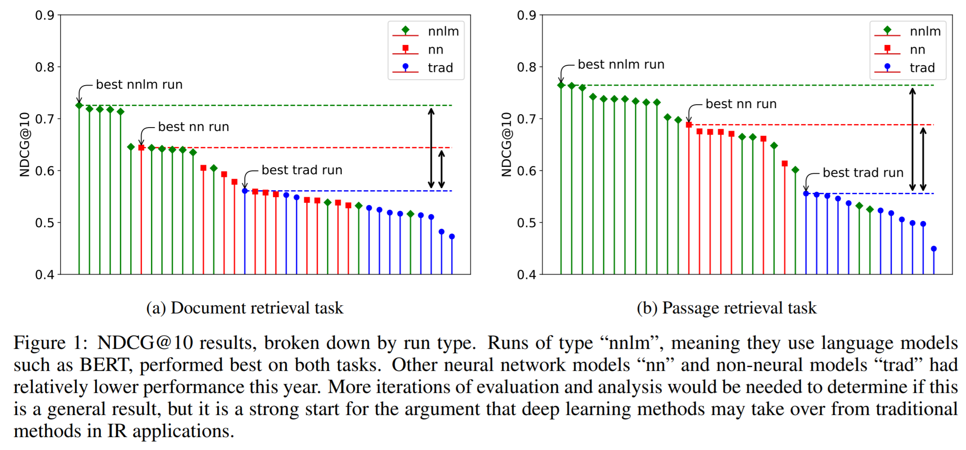

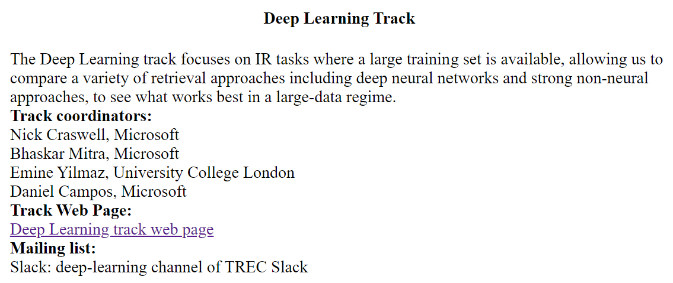
TREC Deep Learning Track w/ document *and* passage ranking tasks
% of neural IR papers @ SIGIR
8%
2016
23%
2017
42%
2018
58%
2019
2020

Slide 15
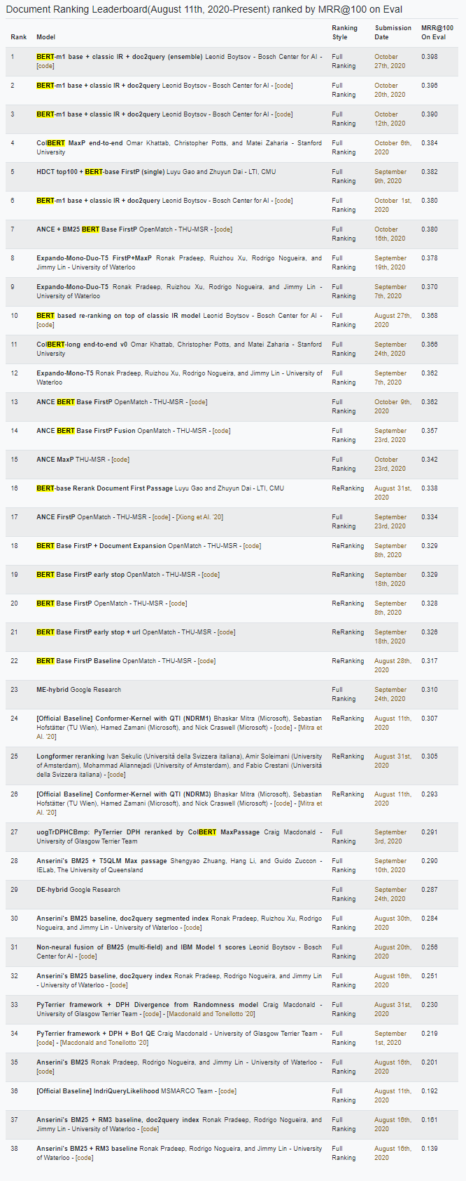
% of neural IR papers @ SIGIR
8%
2016
23%
2017
TREC 2020 Deep Learning Track
+
42%
2018
58%
2019
79%
2020
Document Ranking Leaderboard

Slide 16
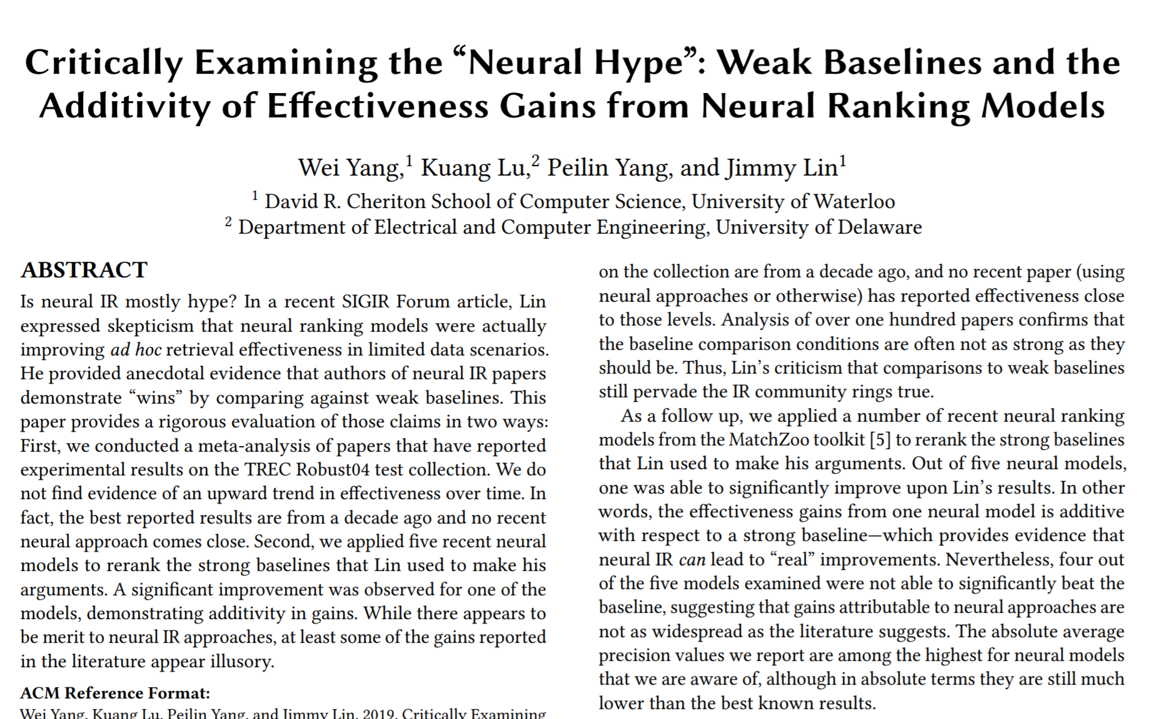
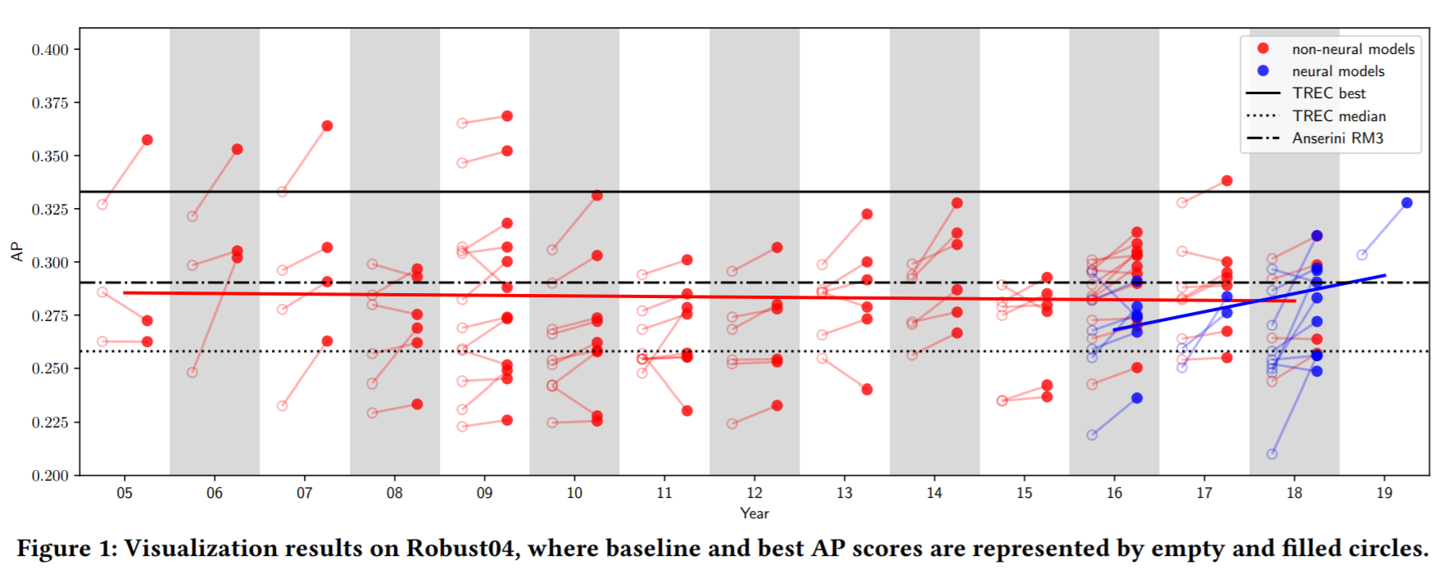
Did neural IR really have a “weak baselines” problem?
I will argue NO: (i) pre-MS MARCO, most neural IR papers that benchmarked on Robust04 (or other older TREC collections) were NOT trained on large labeled datasets and represent a biased sample of neural IR papers, and (ii) even in those cases there is little evidence that these papers employed any weaker
baselines than non-neural IR papers

Slide 17
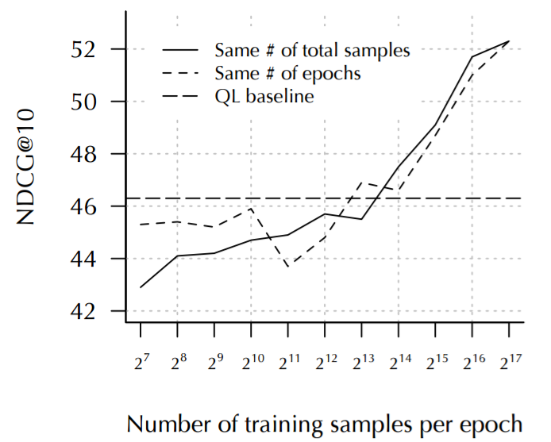

But we had a BIGGER benchmarking problem
The lack of public IR benchmarks with large scale training data led to:
Comparisons under low-data regime
e.g., older TREC collections with few hundred queries
Comparisons on (semi-)synthetic benchmarks
e.g., TREC CAR
Comparisons under weak supervision training
Comparisons on corpus of language different than what the models were designed for
Performance of deep models typically improve with more training data
(image source: The Duet paper)
Non-standardized benchmarks also required reimplementation of baselines (specially, neural baselines) which in turn meant that many of them were under-tuned, in turn, contributing to the “weak baselines” problem!

Slide 18

So, we have ONE public benchmark with large scale training data

Slide 19
Nope.

Slide 20

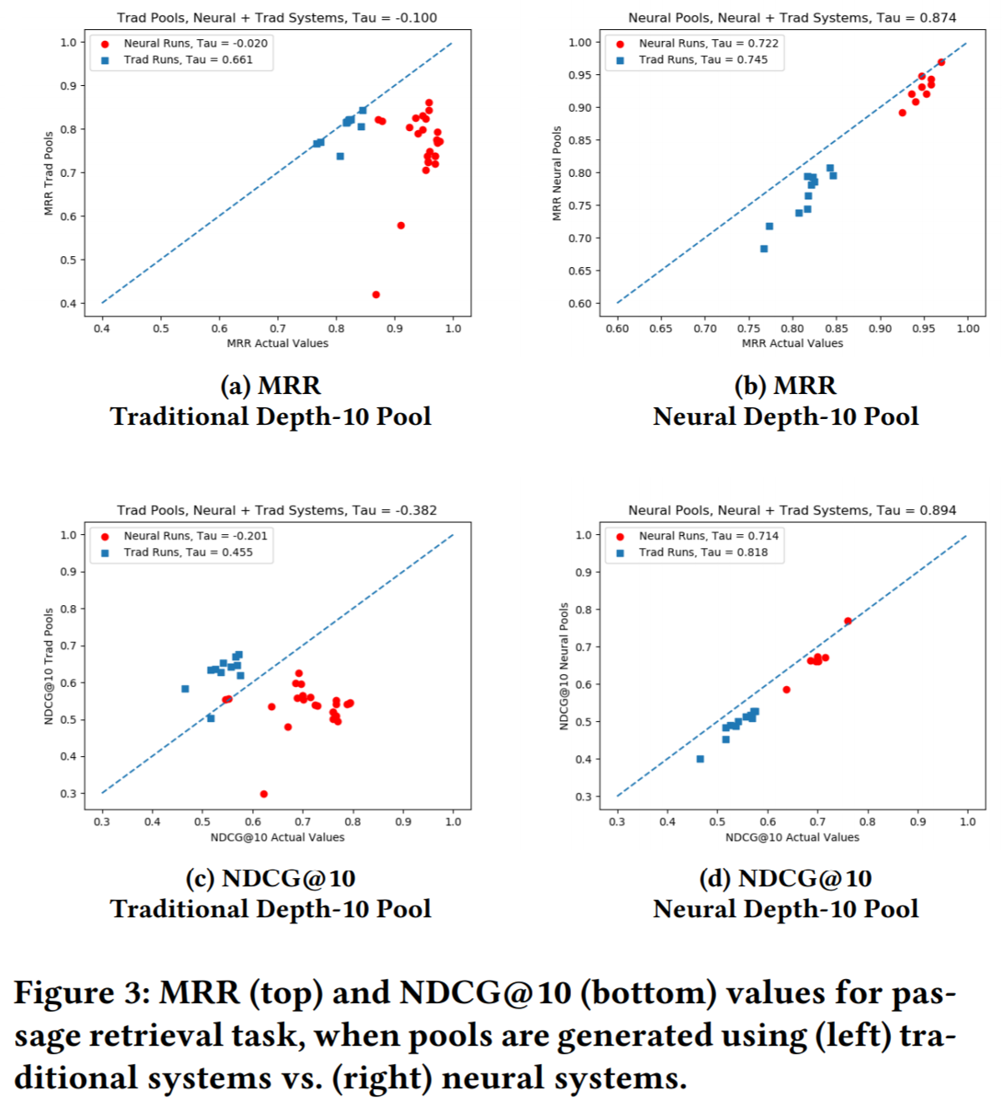
A tale of two benchmarking approaches
TREC-style benchmarking
Annual one-shot submission; strongest protection against overfitting to eval set
Pooling-based judgments after run submission seems most fair to dramatically new methods (Yilmaz et al., 2020)
However, test sets are too small (only tens of queries) to reliably detect small improvements
Having only one opportunity to submit runs per year is very limiting for on-going research
Once the QRELs are public, further evaluation based on the public eval set is less trustworthy and more likely to suffer from overfitting
Image source: Yilmaz et al., 2020

Slide 21
A tale of two benchmarking approaches
MS MARCO leaderboard-based benchmarking
More flexible submission policy convenient for model development but risks overfitting to eval set
Max. one submission per group per week limit provides some safeguard
Evaluation based on sparse labels collected prior to submissions; provides “instant gratification” for participants but may under-estimate performance of new methods
The large test set size (thousands of queries) likely more sensitive to smaller improvements
Originally motivated by a need to provide on-going evaluation support (as opposed to TREC’s once-a-year); but the leaderboard can encourage overly-competitive leaderboard-chasing that muddles any scientific conclusions

Slide 22
Ideally, we should…
Run TREC-style benchmarking but at a higher cadence (e.g., monthly) with pooling-based judging for a fresh test set, that contains at least hundreds (if not thousands) of queries, in every cycle.
…But obviously this requires a *LOT* more resources and work than what we are investing today as a community

Slide 23


But that’s just the tip of the iceberg
Firstly, we have seen huge improvements from BERT on *ONE dataset*; while we anecdotally know that these models outperform traditional methods on proprietary industry benchmarks, we need more large-scale benchmarks to distinguish between general progress in IR vs. incremental metrics improvement specific to the MS MARCO collection
Secondly, BERT hasn’t shown dramatic improvements in IR but specifically on *English queries*; we are not only guilty of Anglocentrism in our current evaluations but in fact our current benchmarking approaches are unlikely to even scale to hundreds (or thousands) of other languages, especially, low resource languages
This is not meant to be a pessimistic message of “Too hard; can’t solve” but rather a call-to-action to the community to come together and think more ambitiously about what IR benchmarking should look like in, say, five years from now.

Slide 24
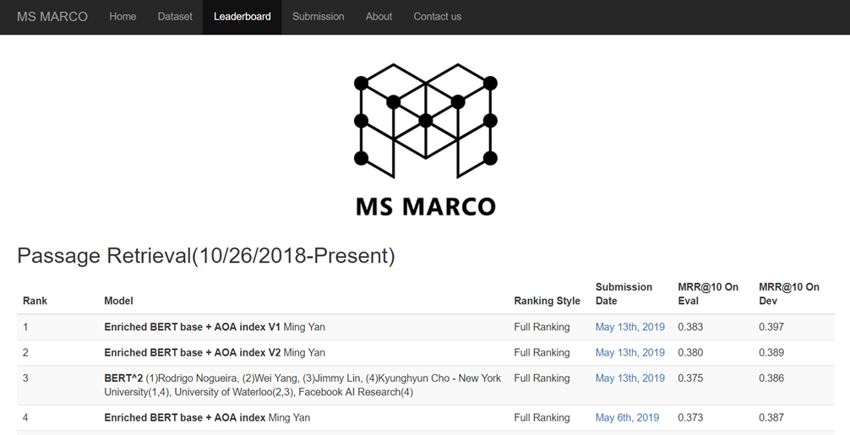
And while we are being ambitious, we would also ❤ to get more participation from the NLP and ML community on the MS MARCO ranking tasks and the TREC Deep Learning Track
MS MARCO: http://www.msmarco.org/
TREC Deep Learning Track: https://microsoft.github.io/TREC-2020-Deep-Learning/
TREC Deep Learning Quick Start: https://github.com/bmitra-msft/TREC-Deep-Learning-Quick-Start

Slide 25


Download: http://bit.ly/fntir-neural
THANK YOU
@UnderdogGeek
bmitra@microsoft.com

